Slide 1
ENVIRONMENTAL SCIENCES AND SUSTAINABILITY
By:
Dr. A. RAVIKRISHNAN,
M.Sc., M.Phil., M.Ed., Ph.D., MISTE., MILCS.,
Asst.Prof of Chemistry.

Slide 2
Sustainability Practices
5.1 ZERO WASTE
Definition
Zero waste is a set of principles, focused on waste prevention, that encourages redesigning resource life cycles, so that all products are reused.
5.1.1 Goal
The material should be reused until the optimum level of consumption is reached.
It provides guidelines for continually working towards eliminating waste.
To avoid sending trash to landfills, incinerators (or) the ocean.

Slide 3
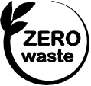
5.1.2 Concept
The conservation of all the resources by means of responsible production, consumption, reuse and recovery of products, packaging and materials without burning and with no discharges to land, water (or) air that threaten the environment (or) human health.
Fig. 5.1 Logo for zero waste

Slide 4
Examples of zero waste
one - way recyclable glass bottles.
one - way milk bags.
one - way aseptic cartons.
one - way table - top paper board cartons.
5.1.3 Principles of zero waste
1. Refuse what you don’t need:
It prevents unwanted items from coming into your home.
2. Reduce what you do use:
It is equal to less waste at the end.
3. Reuse whatever you can.
4. Recycle what you can’t refuse (or) reduce.

Slide 5
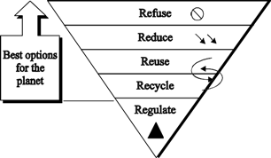
5. Regulate of what’s left over:
Composting food scraps, paper pieces and wooden (or) bamboo tooth brushes returns nutrients and fiber back to the earth.
FLOW CHART
Fig. 5.2 Zero waste Hierarchy

Slide 6
5.1.4 Steps to achieve zero waste
Identify the high waste areas of our life-style.
Know where to apply the principle of zero waste, if the waste cannot be removed (or) reduced.
Substitute single use plastic with eco-friendly zero waste options.
Buy zero waste (or) eco-friendly products.
Support eco-friendly businesses.
Put all your kitchen waste to good use (compositing).
Reuse, up cycle and re-purpose.

Slide 7
5.1.5 Advantages and Disadvantages of zero waste
Advantages (or) Benefits
Zero waste reduces our climate impact.
It conserves resources and minimizes pollution.
It promotes social equity and builds community.
It supports a local circular economy and creates jobs.
Zero waste needs businesses to play a key role.

Slide 8
Disadvantages (or) problem of zero waste
Since zero wastes are solids, it is difficult to store.
It is more expensive.
Zero waste in time-consuming.
It can cause anxiety.
Zero waste can be misleading.
It can be difficult for a large household.
Zero waste products are hard to find.

Slide 9
5.2 R CONCEPT (OR) 3R CONCEPT (REDUCE,REUSE AND RECYCLE)
Definition
The principle of reducing waste, reusing and recycling resources and products is often called 3Rs.
1. Reduce
Reducing means choosing to use things with care to reduce the amount of waste generated.
If the usage of raw materials are reduced, the generation of waste also gets reduced.

Slide 10
2. Reuse
Reusing involves the repeated use of items (or) parts of items which still have usable aspects.
The refillable containers, which are discarded after use, can be reused.
Rubber rings can be made from the discarded cycle tubes, which reduces the waste generation during manufacturing of rubber bands.
3. Recycle
Recycling means the use of waste itself as the resources.
It involves reprocessing of the discarded materials into new useful products.

Slide 11
Examples
Old aluminium cans and glass bottles are melted and recast into new cans and bottles.
Preparation of cellulose insulation from paper.
Preparation of fuel pellets from kitchen waste.
Preparation of automobiles and construction materials from steel cans.
The above process saves money, energy, raw materials, and reduces pollution.

Slide 12

5.2.1 Concept of 3R
The concepts of 3R refers to reduce, reuse and recycle, particularly in the topic of production and consumption.
It forces for an increase in the ratio of recyclable materials, further reusing of raw materials and manufacturing wastes and overall reduction in resources and energy used.
Fig. 5.3 3R Concept

Slide 13
5.2.2 Principle
3R is the order of priority of actions to be taken to reduce the amount of waste generated and to improve overall waste management processes and programs.
5.2.3 Importance of 3 Rs
The most effective way to reduce the garbage is reducing the amount of solid waste produced.
By reducing waste at the source, the resources like water and energy can be saved.
Like reducing, reusing avoids creating waste rather than trying to recycle it once it’s already there.
Operating a well-run recycling program costs less than waste collection and land filling.

Slide 14
Recycling helps families save money because they pay for less disposal costs.
recycling produces less air and water pollution than manufacturing with new materials.
By recycling less materials are sent to landfills, which will keep them for future.
Proper disposal and recycling will prevent water and soil contamination.
5.2.4 Advantages and disadvantages of 3 Rs
Advantages (or) Benefits of 3 Rs
Reduce greenhouse gas emissions.
Saves energy.

Slide 15
Helps sustain the environment for future generations.
Reduces the amount of waste that will need to be recycled (or) sent to landfills and incinerators.
Save money.
Prevent pollution.
Disadvantages of 3 Rs
High upfront capital cost.
Recycling sites are always unhygienic, unsafe and unsightly.
Products from recycled waste may not be durable.
Recycling might not be inexpensive.

Slide 16
3R is more energy consumption and pollution.
3R generates pollutants.
Processing cost is high.
Quality of resultant product is low.
5.3 CIRCULAR ECONOMY
Definition
Circular economy is a new production and consumption model that ensures sustainable growth over time. It reduces the consumption of raw materials and recover wastes by recycling (or) giving it a second life as a new product.

Slide 17
5.3.1 Aim (or) Purpose
Aim of the circular economy is to make the most of the material resources available to us by applying three basic principles reduce, reuse and recycle.
In this way the life cycle of products is extended, waste is used and a more efficient and sustainable production model is established over time.
5.3.2 Benefits of circular economy
It protects environment.
Circular economy benefits the local economy.
It drives employment growth.
It promotes resource independence.

Slide 18
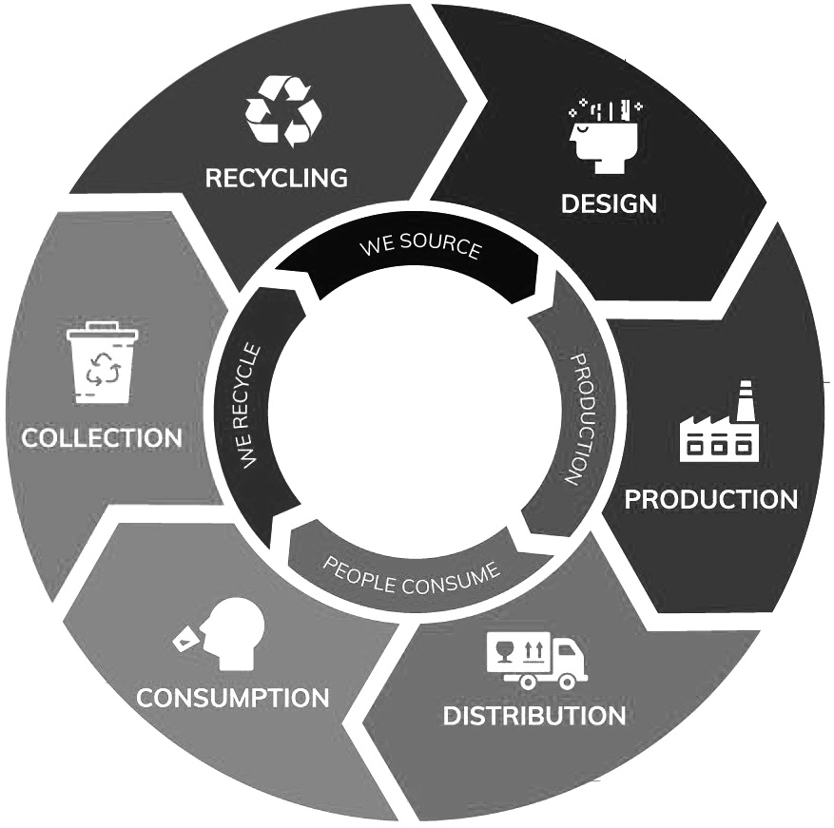
Fig. 5.4 Circular Economy

Slide 19
5.3.3 Necessary steps (7Rs) to achieve a circular economy
1. Redesign
Redesigning process consumes fewer raw materials, extends their life cycle and generates less waste.
2. Reduce
If we reduce consumption, waste generation and use of raw materials, impact on the environment gets reduced.
3. Reuse
Reusing the products extends their life cycle.
4. Repair
Repairing avoids the use of new raw materials, saves energy and does not generate environmental waste.

Slide 20
5. Renovate
Update old objects, so that they can be reused.
6. Recycle
Waste product can be used as raw material to manufacture new products.
7. Recover
The products that are going to be discarded, can be used for new uses.
Example for Circular Economy
Manufacturers design products to be reusable.
Electrical devices are designed in such a way that they are easier to repair. Products and raw materials are also reused as much as possible.

Slide 21
5.4 ISO 140000 SERIES
ISO
ISO is an International Organization for Standardization.
It is composed of representatives from various national standard organizations.
It provides standards and guidelines for a variety of businesses and purposes and publishes technical reports.
ISO 14000 series
It is a family of standards related to environmental management that exist to help organizations.
minimize how their operations negatively affect the environment.
comply with applicable laws, regulations and other environmentally oriented requirements.
continually improve with above.

Slide 22

5.4.1 Objective of ISO14000 series
The primary objective of ISO14000 series of standard is to promote effective environmental management systems in organizations.
Fig. 5.5 Logo of ISO

Slide 23
5.4.2 List of ISO 14000 Series Standards
It includes a catalogue of over 50 Environmental management and performance related standards.
But some important ISO14000 series standards are listed here.
Standard | Title | Applications
ISO14001 | Environmental management system. | Requirements with guidance for use.
ISO14004 | Environmental management system. | General guidelines on implementation.
ISO14005 | Environmental management system. | Guidelines for flexible approach to implementation.

Slide 24
Standard | Title | Applications
ISO14015 | Environmental management. | Environmental assessment of sites.
ISO14020 to 14025 | Environmental management. | Environmental labels and declarations.
ISO14030 | Green bonds. | Environmental performance of nominated projects and assets.
ISO14031 | Environmental management. | Environmental performance evaluation & Guidelines.
ISO14040 to 14049 | Environmental management. | Discusses pre-production planning.

Slide 25
Standard | Title | Applications
ISO14050 | Environmental management. | Vocabulary, terms and definitions.
ISO14062 | Environmental management. | Product design and development.
ISO14063 | Environmental management. | Guidelines and examples.
ISO14064 | Environmental management. | Reducing green house gas emissions.
ISO14090 | Environmental management. | Adaptation of climate change.

Slide 26
5.4.3 Core elements of ISO 14000
It contains the following six key elements.
Environmental policy.
Planning.
Implementation and operation.
Checking and corrective action.
Management review.
Continuous improvement.

Slide 27
5.4.4 Advantages and disadvantages of ISO14000
Advantages (or) Benefits
The following five important benefits of quality management system
It identifies risks and opportunities.
It prevents problems from reoccurring.
It boosts your marketing and sales efforts.
It improves employee performance.
It improves your control over the business.

Slide 28
It lowers costs like energy bills, tax and insurance bills.
It helps to reduce waste.
It helps to minimize the carbon footprint of a company.
It is recognised internationally.
It gives immediate notice about the environmental performance of a company.
Disadvantages (or) limitations
It is extremely costly to implement if not done properly.
It requires a lot of administrative work.

Slide 29
No improvement in environmental performance.
Organizations face a lot of challenges while implementing this standards.
5.5 MATERIAL LIFE CYCLE ASSESMENT
Definition
Life cycle assessment (LCA) is a process of evaluating the effects of a material on the environment over the entire period of its life, there by increasing resource use efficiency and decreasing liabilities.
Generally LCA is used to study the environmental impact of a material.
LCA is commonly referred to as a cradle-to-grave analysis.

Slide 30
5.5.1 Stages of a life cycle assessment
The followings are the 5 stages of a life cycle assessment
Step 1: Raw materials (Resources) extraction and processing.
Step 2: Manufacturing.
Step 3: Transportation.
Step 4: Distribution.
Step 5: Usage and retail.
Step 6: Waste disposal (end of life).

Slide 31
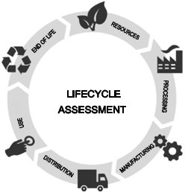
Fig 5.6 Life cycle assessment

Slide 32
In the manufactured product, environmental impacts are assessed from raw material extraction and processing, through the product’s manufacture, distribution and use, to the recycling (or) final disposal of the materials.
5.5.2 Benefits (or) Advantages of LCA
LCA is widely used to support sustainable development.
LCA allows decision makers to compare two products and to select the product that has lowest impact on the environment.
It is a modelling tool to assess environmental impacts of a product during its entire lifespan.
LCA provides a holistic view on the environmental impacts, to avoid optimizing one environmental indicator without considering the effects on the other indicators.
LCA identifies hotspots in the environmental impact.
LCA is purely based on internationally accepted standards.

Slide 33
5.5.3 Disadvantages (or) Limitations
LCA assesses the real world in a simplified model.
The assumptions, scenaries and scope may vary from one study to the other leading to different LCA results.
Variations in LCA approaches and results may be confusing especially for non-experts.
LCA study requires large amount of data.
If data collection is poor, the study will not lead to solid conclusions.
It is not easy to communicate the results of a LCA study.

Slide 34
5.6 ENVIRONMENTAL IMPACT ASSESSMENT
EIA is defined as a formal process of predicting the environmental consequences of any development projects.
It is used to identify the environmental, social and economic impacts of the project prior to decision making.
5.6.1 Purpose (or) Aim of EIA
The main purpose of EIA is to determine the potential environmental, social and health effects of a proposed developmental projects.
5.6.2 Objectives of EIA
To identify the main issues and problem of the parties.
To identify who is the party.

Slide 35
To identify what are the problems of the parties.
To identify why are the problems arise.
5.6.3 Benefits of EIA
Cost and time of the project is reduced.
Performance of the project is improved.
Waste treatment and cleaning expenses are minimised.
Usages of resources are decreased.
Biodiversity is maintained.

Slide 36
Human health is improved.
It helps in preventing natural calamities like earthquake, cyclone, etc.,
5.6.4 Process of EIA (or) Key Elements of EIA
The key elements used in the process of EIA are
Scoping
Screening
Identifying and evaluating alternatives
Mitigating measures dealing with uncertainty
Issuing environmental statements

Slide 37
1. Scoping
It is used to identify the key issues of the concern in the planning process at an early stage. It is also used to aid site selection and identify any possible alternatives.
2. Screening
It is used to decide whether an EIA is required (or) not based on the information collected.
3. Identifying and evaluating alternatives
It involves knowing alternative sites and alternative techniques and their impacts.
4. Mitigating measures dealing with uncertainty
It reviews the action taken to prevent (or) minimize the adverse effects of a project.
5. Environmental statements
This is the final stage of the EIA process. It reports the findings of the EIA.

Slide 38
5.7 SUSTAINABLE HABITAT
Sustainable habitat means the maintenance of our natural home.
Definition
A sustainable habitat is an ecosystem that produces food and shelter for people and other organisms without resource depletion ie., no external waste is produced.
5.7.1 Features (or) Characteristics of sustainable habitat
Proper waste management.
Affordable housing.
Waste water treatment and facility of recycling waste water.
Green transportation using green fuel like biodiesel.

Slide 39
5.7.2 Objectives of national mission on sustainable habitat
To reduce energy demand by promoting alternative technologies and energy conservation practices in both residential and commercial areas.
Better urban planning like
using better disaster management
lesser use of private transport
more usage of public transport
Encourage community involvement and participation of stake holders.
Conservation of natural resources such as clean air, water, flora and fauna.
Facilitate the growth of small and medium cities.
To create sustainable habitats, engineers and architects should not consider any element as a waste product.

Slide 40
How to maintain sustainable habitat
For maintaining our sustainable habitat, we should
Promote energy efficiency.
Promote the use of eco-friendly fuels.
Better manage municipal solid waste.
Promote to public transport.
5.8 GREEN BUILDINGS
Definition
Green building is an efficient method of construction that produces healthier buildings, which have less impact on the environment and climate. It requires less cost to maintain.
Green buildings preserve previous natural resources and improve our quality of life.

Slide 41
5.8.1 Criteria for green building
Green builders are encouraged to build on previously developed land rather than developing new land.
It is also important to build near existing infrastructure like bus routes, market, libraries.
The building site should be smaller because there is less environmental foot print.
Sites must be sustainably landscaped and don’t suffer from soil erosion (or) light pollution.
Water reduction is built in by design using low-flow toilets, grey water systems.
Green buildings are constructed using clean energy like geothermal, solar, wind energies.
Green builders reduce material usage wherever possible. Mainly they use natural, renewable sources.
Selecting low emitting materials and products not only improves human health but also protect the overall environment.

Slide 42
5.8.2 Features of green building
Efficient use of energy, water and other resources.
Use of renewable energy such as solar energy.
Pollution and waste reduction measures ie., reuse and recycling.
Good indoor environmental air quality.
Use of materials that are non-toxic, ethical and sustainable.
A design that enables adaptation to a changing environment.
Consideration of the quality of life of occupants in design, construction and operation.
Construction of the environment in design, construction and operation.
Thus, any building can be a green building whether it is a home, an office, a school, a hospital, a community centre provided it includes features listed above.

Slide 43
5.8.3 Principles of green building
The five principles of green building are
Livable communities.
Energy efficiency.
Indoor air quality.
Resource conservation.
Water conservation.
5.8.4 Components of green building
Seven important components of green buildings are
Aluminium weather resistant insulated access panel. It helps regulate in door temperature and prevent moisture and pest from entering.
Energy efficient windows.
Green roof.

Slide 44
Solar power.
Water conservation.
Recycling.
Landscaping.
5.8.5 Advantages and Disadvantages of green building
Advantages of green buildings
Green buildings are energy efficient.
Higher fraction of eco-friendly materials.
Water - efficient devices.
Reduction in waste.
Less air pollution.
Reduction in green house gas emissions.
Protection of our natural resources.
Indoor air quality is improved.
Use of recycled metal and other construction materials.

Slide 45
Emphasis on renewable energies.
Day lighting is utilized as best as possible.
Use of renewable plant materials.
Higher market value.
Rainwater collection and use of compost bins.
Overall health improvements.
Disadvantages of green building
High initial costs.
Energy supply may depend on weather condition.
Technology problems are more.
Maintenance may be difficult.
Indoor air temperature may greatly vary over time.
Experienced green construction workers may be rare.
Green construction is not suitable for all locations.
Availability of green construction materials.
Funding problems for green buildings.

Slide 46
5.9 GREEN MATERIALS
Definition
Green materials also called eco-friendly materials, building construction materials that have low impact on the environment. Due to the properties of non-toxic, organic and recycling, green materials are widely used in various industrial applications.
Examples: Naturally occurring materials like wood, ceramics, glass, clay, sand, stone.
5.9.1 Criteria for green materials
Following criteria can be used to identify the green materials.
Local availability of materials.
Embodied energy of materials.
% of recycled (or) waste materials used.

Slide 47
Rapidly renewable materials.
Contribution in energy efficiency of building.
Recyclability of materials.
Durability.
Environmental impact.
Evolution of the material can be made using the mentioned criteria.
5.9.2 Characteristics of green materials
Common characteristics of green materials are
Green materials are energy efficient products, it uses less energy to do the same task.
It lowers energy cost and lessen pollution.
Green materials are mostly renewable, can be regenerated again and again.
Example Bamboo grows quickly while pine grows more slowly, but both are renewable.

Slide 48
Green materials are recyclable (or) made from recycled material. So, they save energy and reduce waste.
Green materials are non-toxic, they do not emit odors, irritants (or) hazardous compounds that affect human health.
They are durable and no need to upgrade (or) repair. They preserve resources and energy.
They are cost-effective.
They can be locally sourced, so transport cost can be reduced.
5.9.3 Important green building materials
Green building is construction that primarily uses natural materials and renewable resources. These structures look really cool.
1. Stone: It is low maintenance and durable.

Slide 49
2. Cob:
(mud mixture of natural ingredients like soil, sand, straw and lime).
It is cheap and energy efficient.
3. Bamboo
It is durable and light weight.
4. Cork: (Cork canes from oak trees).
It is a very good thermal insulator and mold resistant
5. Adobe brick: (brick made of clay and straw).
Natural noise protection and posses unique design (can be easily cut and transformed).
6. Straw bale
Easily renewable and cheap.
7. Cord wood
Affordable (cheap and easy construction), thermal efficiency.

Slide 50
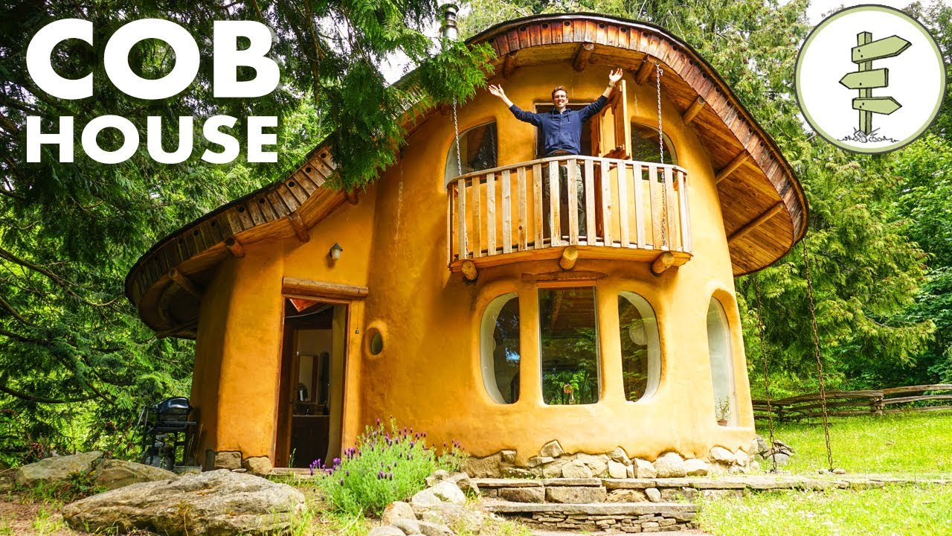
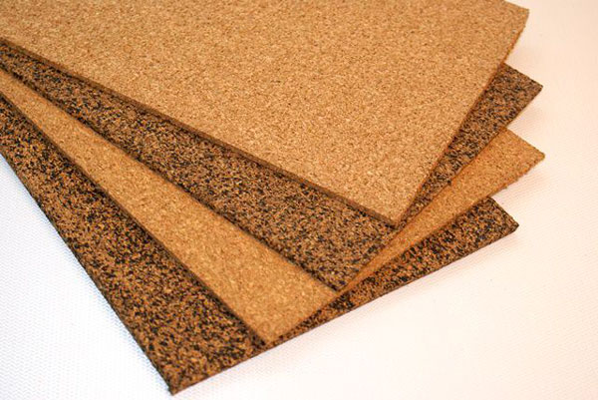
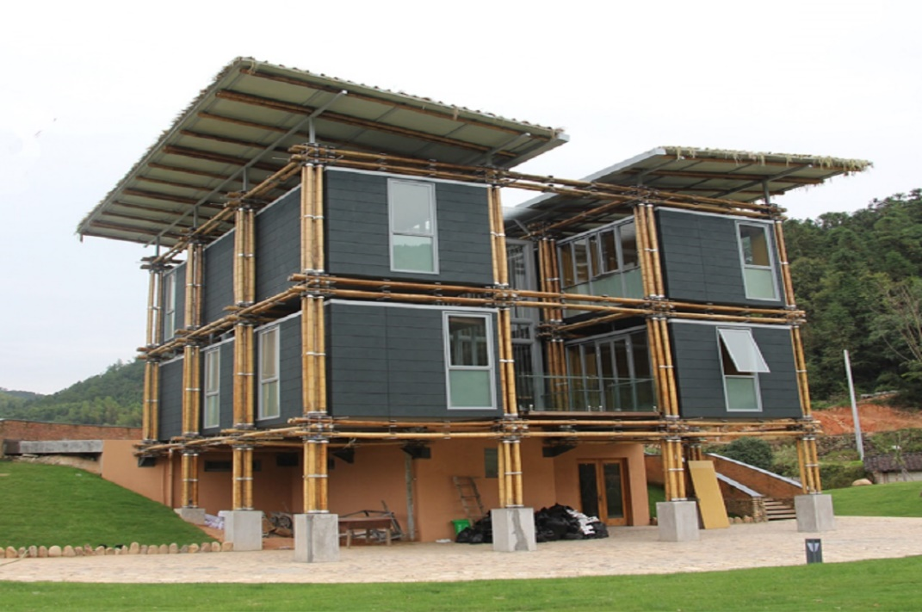
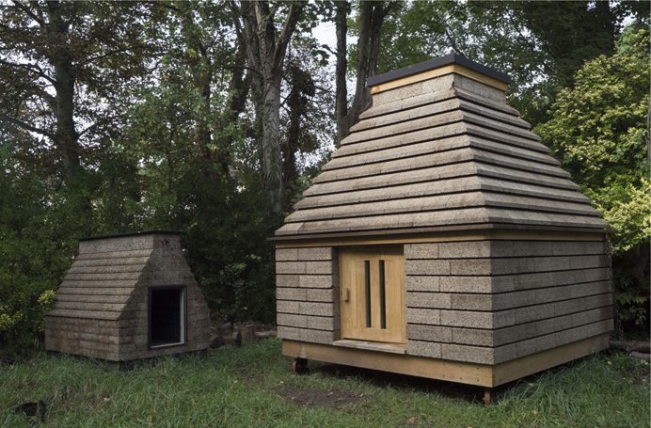
Cork house
Bamboo house

Slide 51
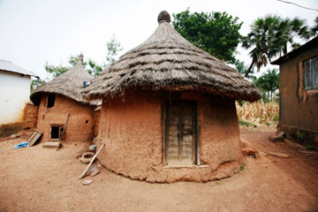
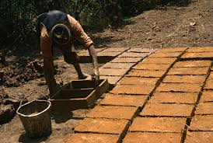
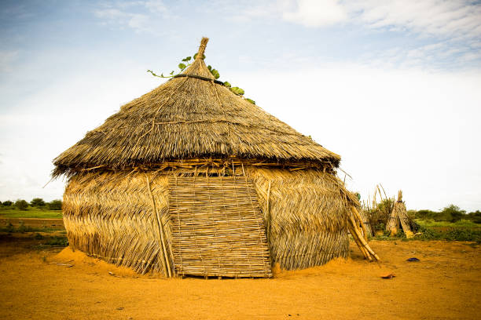
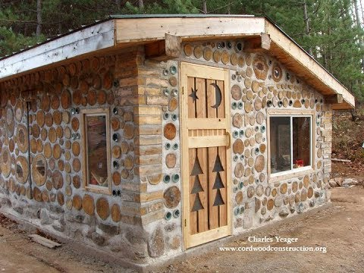
Adobe brick house
Cord wood house
Straw house

Slide 52
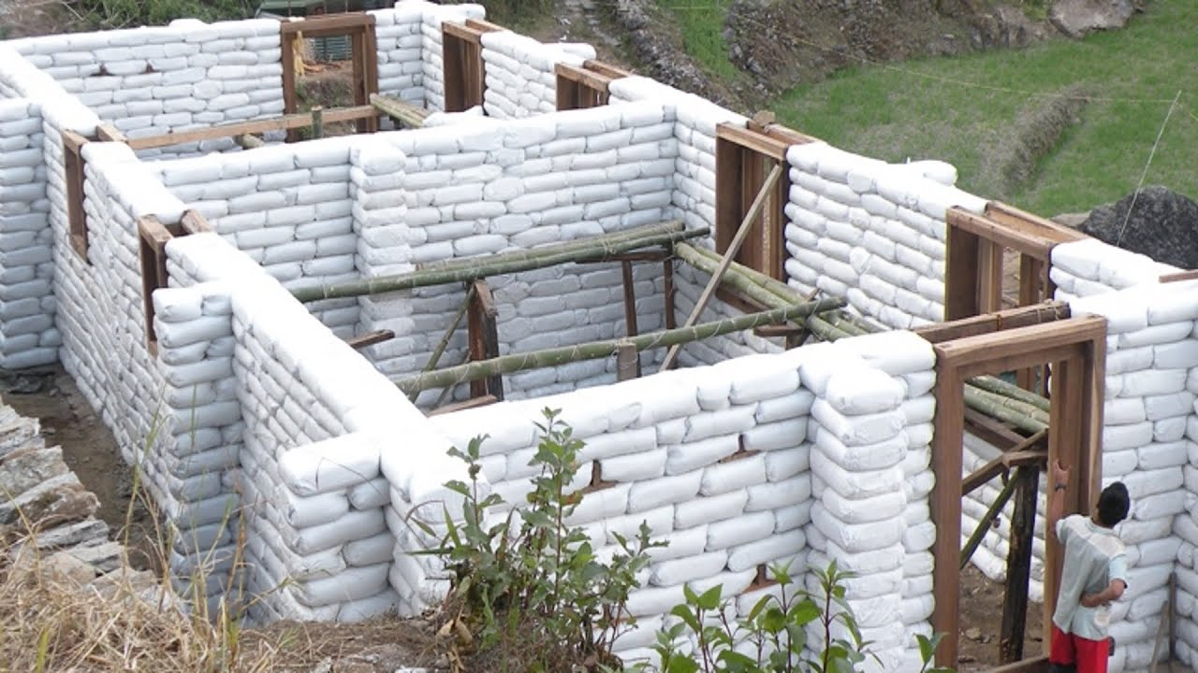
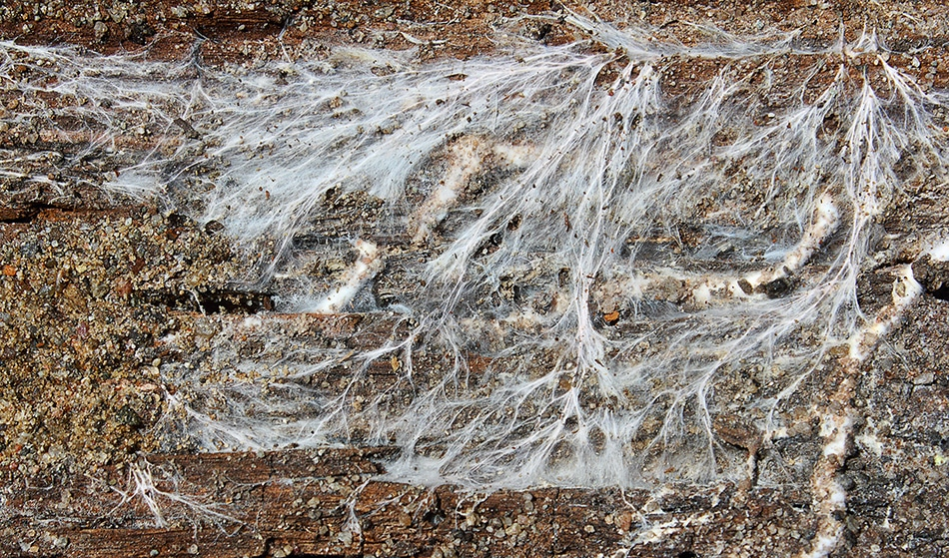
Sand bag house
Mycelium fungi house

Slide 53
8. Earth bags (or) sand bags
Locally sourced and provide natural insulation.
9. Mycelium (or) mushroom roots
Strong and light weight.
5.9.4 Examples of green materials
Bamboo floorings.
LED lightings.
Reclaimed wood.
Energy efficient appliances.
High-efficiency glass windows.
Solar panels.

Slide 54
Recycled steel.
Cork.
Precast concrete slabs.
Low VOC paint.
5.10 ENERGY EFFICIENCY
Definition
Energy efficiency is the use of less energy to perform the same task (or) produce the same result.
Energy efficient homes and buildings use less energy to heat, cool and run appliances and electronics.

Slide 55

Fig. 5.7 Energy efficiency logo

Slide 56
5.10.1 Methods of achieving energy efficiency
Energy efficiency can be achieved by the following methods.
Alternative waste treatment.
Avoided emissions from diverting legacy waste from landfill for process engineered fuel manufacture.
Avoided emissions from diverting legacy waste from landfill through a composting alternative waste technology.
Capture and combustion of landfill gas.

Slide 57
5.10.2 Calculation of energy efficiency
Energy efficiency can be calculated using the following relation.
energy output
Energy efficiency = × 100%
energy input
wout
η = × 100%
win

Slide 58
5.10.3 Advantages (or) Benefits of energy efficiency
Using energy more efficiently is one of the fastest, most cost - effective ways to save money.
Increased energy efficiency can lower greenhouse gas emissions and other pollutants.
Energy efficiency also decreases water use.
It can lower individual utility bills, create jobs and help stabilize electricity prices.
It provides long-term benefits by lowering overall electricity demand, thus reducing the need to invest in new electricity generation and transmission infrastructure.
Energy efficient construction is environmentally - friendly as it does not emit harmful carbon dioxide into the atmosphere.

Slide 59
Example
Energy - efficient LED light bulbs are able to produce the same amount of light as incandescent light bulbs by using 75 to 80% less electricity.
5.10.4 Disadvantages (or) limitations of energy efficiency
Energy efficient construction is the high cost of enforcing ie., addition cost is required to build and plan such buildings.
Building materials are not always available.
Although energy efficient construction is environmentally friendly, it produces less carbon emissions and has slight unfavorable effects on the human health.
Indoor air is 3 to 7 times more polluted than outdoor air.

Slide 60
5.11 SUSTAINABLE TRANSPORT
Definition
Sustainable transport refers to any means of transportation that is “green” and has low impact on the environment.
Examples
walking
cycling
transit
carpooling
car sharing
green vehicles

Slide 61
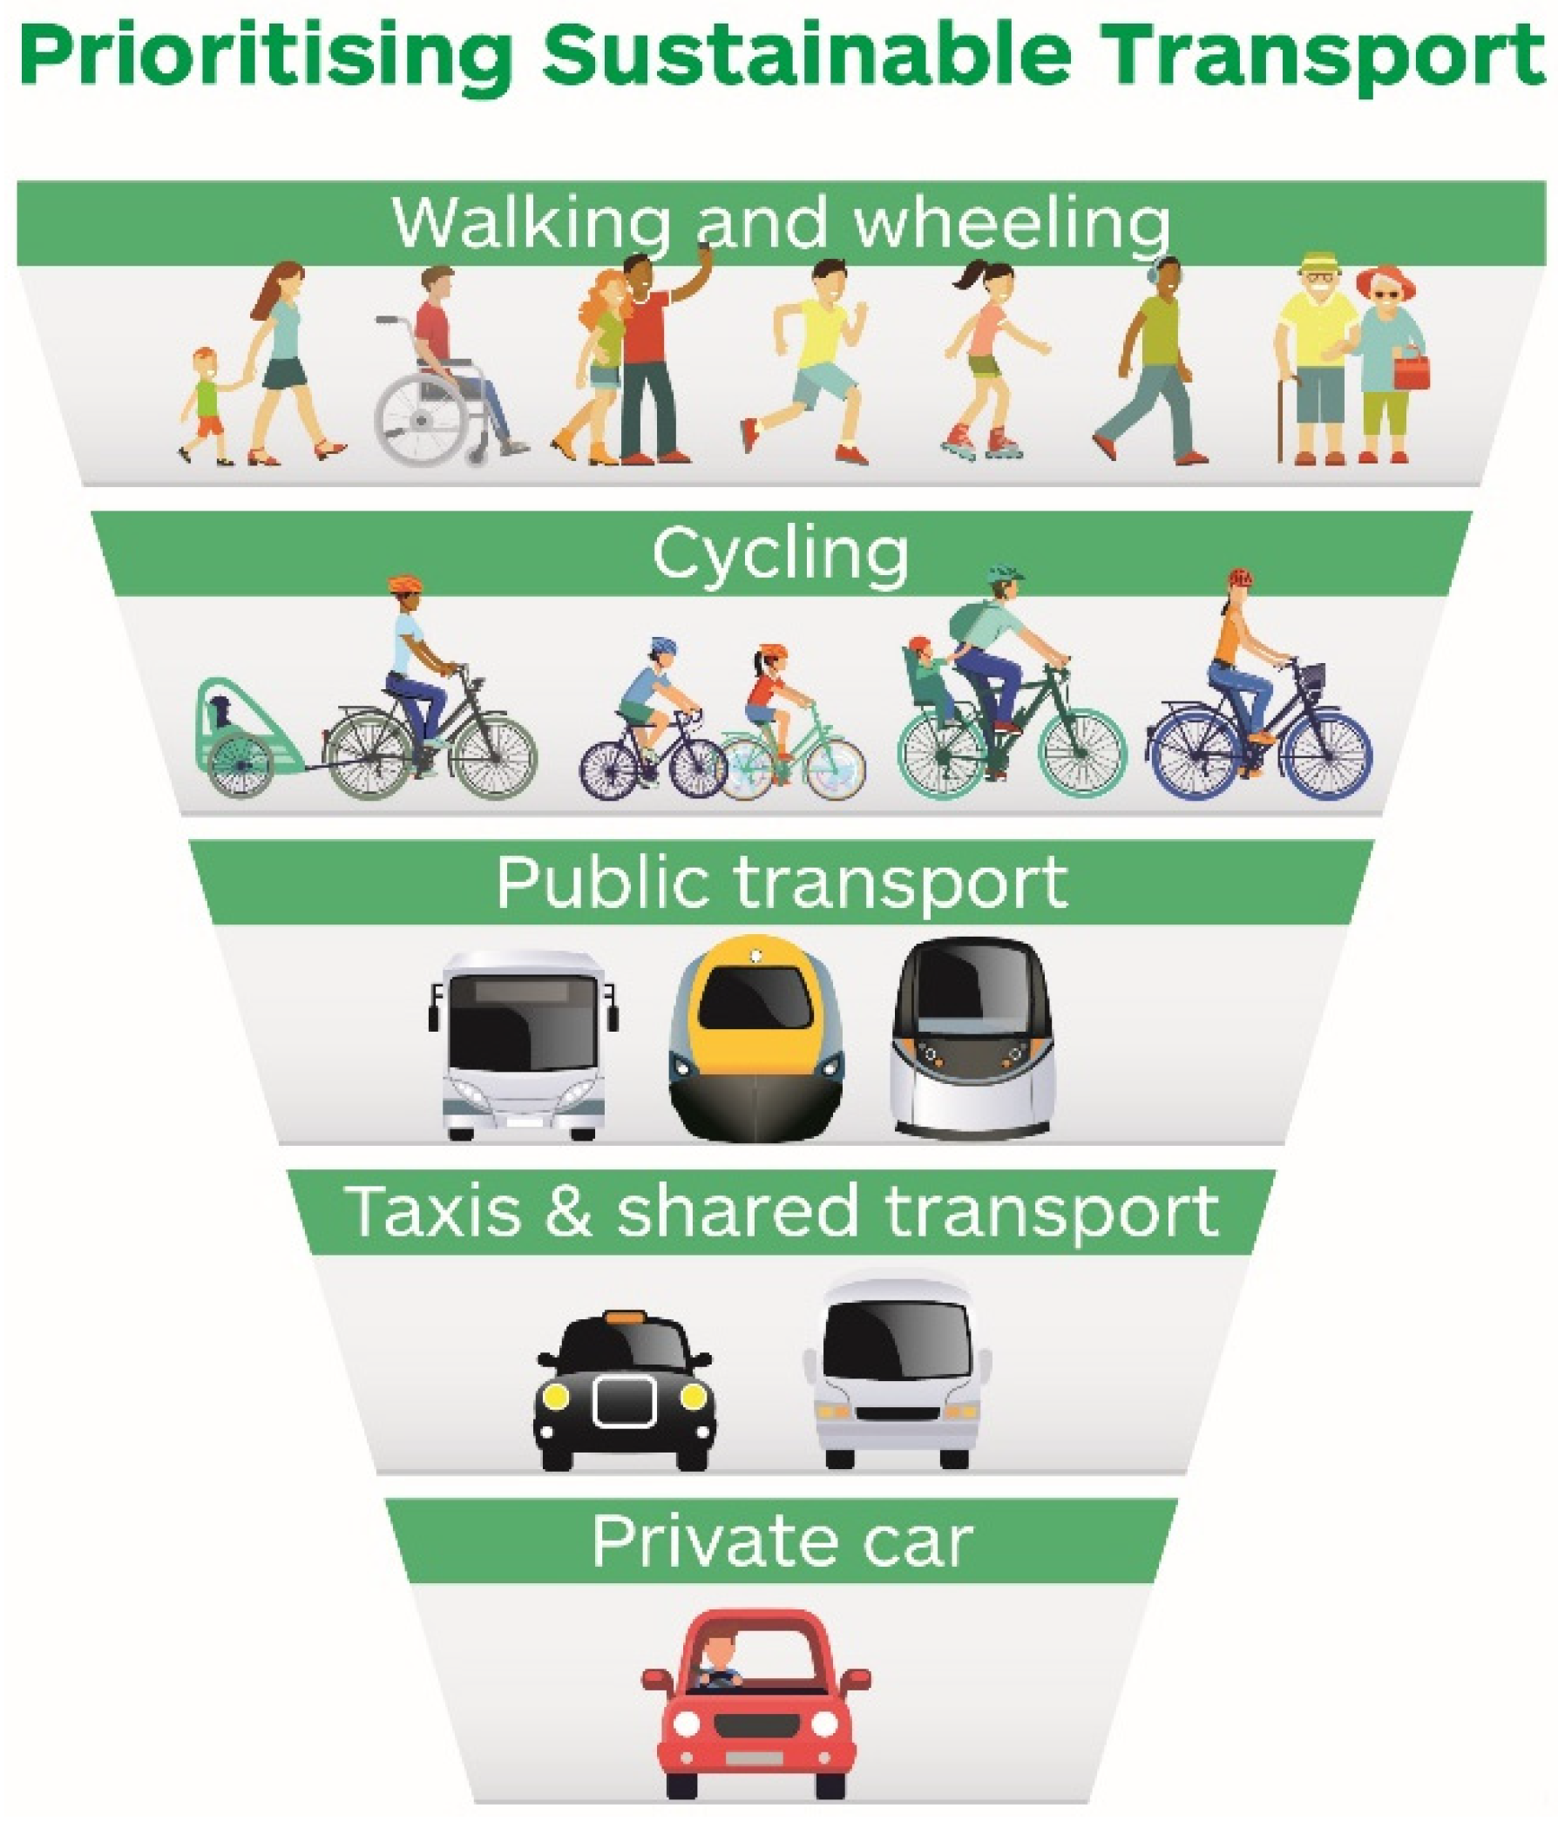

Slide 62

Sustainable transport can carry people for more efficiently than cars.
Electric cars pollute less and reduce individual carbon foot prints.
Fig. 5.8 Sustainable transport

Slide 63
5.11.1 Importance of sustainable transport
Sustainable transport contributes to reduction in damaging CO emission and therefore to a reduction in atmospheric pollution and improved air quality in cities.
The aim of this type of transport is to reduce the negative impacts on the environment.
5.11.2 Key elements of sustainable transport
1. Fuel economy
The better fuel economy gets the lower emissions go. By improving fuel economy we can get the same mileage while generating fewer emissions.
It is achieved by
making engines more efficient.
vehicles lighter and bodies more aerodynamic.
2

Slide 64
2. Occupancy
The cheapest and simplest way to lower the carbon intensity of a vehicle is to stick more people in the vehicle.
Example
Local bus has emissions 7 times higher than the school bus.
The main difference is that the school bus has very high occupancy.
3. Electrification
Electrification is the most important pathway to low carbon transport.
4. Pedal power
Bicycles reduces the carbon emissions.
5. Urbanization
It is a huge opportunity for lowering both distance travelled per person and the carbon intensity of that travel.

Slide 65
5.11.3 How to Promote sustainable transport
Followings are steps for promoting sustainable transport.
1. Enhancing public transportation:
It is not only less polluting means of transportation, but also promoting HSE (Health, safety and environment) policy.
2. Encouraging car pooling:
It reduces the volume of CO , emitted per inhabitant.
3. Encouraging bicycle use:
It is reliable and non-polluting means of transportation.
4. Teleworking:
It reduces employee travel and therefore their carbon food print.
5. Improving the parking experience:
It can be done effectively with the help of a parking management
software.
2

Slide 66
5.11.4 Advantages and Disadvantages of sustainable transport
Advantages (or) benefits
It creates job.
Provides safer transportation.
Emits less pollution.
Promotes health (sustainable transit reduces emissions and air pollution)
It saves energy.
Saves money.

Slide 67
7. Decreases congestion:
When people choose sustainable transportation, over driving themselves, congestion also decreases.
8. It conserves land.
It encourages compact development, fewer roadways in country areas results in less runoff, thereby protecting the land and the biodiversity.
Disadvantages (or) limitations
Modifications to handling and transport facilities.
The initial purchase of reusable containers.
Additional costs of the tracking system e.g., software packages, reading equipments, electronic chips, barcode labelling, detector’s etc.,

Slide 68
5.12 SUSTAINABLE ENERGY
Definition
Sustainable energy is the energy which meets the needs of present without compromising the ability of future generations to meet their own needs.
It should be encouraged as it does not cause any harm to the environment and is available widely at free of cost.
5.12.1 Sources of sustainable energy
Followings are the sustainable enery sources as they are stable and available in plenty.
Wind energy.
Solar energy.
Ocean energy.
Hydro power.
Geothermal energy.

Slide 69
5.12.2 Advantages and disadvantages of sustainable energy
Advantages (or) Benefits
1. Improves public health
Burning of fossil fuels produces serious public health issues like neurological damage, cancer, heart attacks, breathing problems and premature death.
However these problems can be eliminated by using sustainable energy sources, which emit no air (or) water pollutants.
2. Creates local jobs
Since most of the sustainable energy infrastructure is built locally (or) in the same country, it helps creates jobs and improves the economy.

Slide 70
3. Decrease your carbon footprint
Sustainable energy like wind and solar energy creates zero carbon emissions.
4. Cost saving
As it is easily available they are much more cost-effective than traditional energy resources, such as power plants
5. Energy security
It helps to conserve the planet’s natural resources and reduce the pollution.

Slide 71
Disadvantages (or) limitations
Sustainable energy sources are not available round the clock.
The efficiency of sustainable energy technologies is low.
The initial cost of sustainable energy is high.
Sustainable energy sites require a lot of space.
Sustainable energy devices need recycling.

Slide 72
5.13 NON-CONVENTIONAL SOURCES (OR) RENEWABLE ENERGY SOURCE
Non-conventional sources are natural resources which can be regenerated continuously and are inexhaustible.
They can be used again and again in an endless manner.
Examples Wood, solar energy, wind energy, hydropower, tidal energy, etc.,
Merits of Non-conventional energy resources
Unlimited supply.
Provides energy security.
Fits into sustainable development concept.
Reliable and the devices are modular in size.
Decentralized energy production.

Slide 73
5.13.1 Solar energy
The energy that we get directly from the sun is called solar energy.
The nuclear fusion reactions occurring inside the sun release enormous amount of energy in the form of heat and light.
Several techniques are available for collecting, converting and using solar energy.
Some important solar energy harvesting devices are given below.

Slide 74
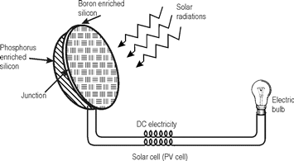
1. Solar cells (or) photovoltaic cells (or) PV cells
Fig. 5.9 Solar cell

Slide 75
Solar cells consists of a p-type semiconductor (such as Si doped with B) and n-type semiconductor (such as Si doped with P).
They are in close contact with each other.
When the solar rays fall on the top layer of p-type semiconductor, the electrons from the valence band get promoted to the conduction band and cross the p-n junction into n-type semiconductor.
There by potential difference between two layers is created, which causes flow of electrons (ie., an electric current).
Uses
Used in calculators, electronic watches, street lights, water pumps to run radios and TVs.

Slide 76
1.Solar Battery
When a large number of solar cells are connected in series it form a solar battery.
Solar battery produce more electricity which is enough to run water pump, to run street-light, etc.,
They are used in remote areas where conventional electricity supply is a problem.
2. Solar heat collectors
Solar heat collectors consist of natural materials like stones, bricks (or) materials like glass, which can absorb heat during the day time and release it slowly at night.
Uses
It is generally used in cold places, where houses are
kept in hot condition using solar heat collectors.

Slide 77
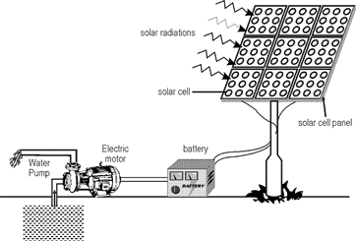
Fig. 5.10 Solar pump run by solar cells (Battery)

Slide 78
3. Solar water heater
It consists of an insulated box inside of which is painted with black paint.
It is also provided with a glass lid to receive and store solar heat.
Inside the box it has black painted copper coil, through which cold water is allowed to flow in, which gets heated up and flows out into a storage tank.
From the storage tank water is then supplied through pipes.

Slide 79
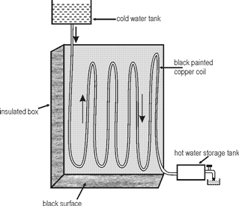
Fig. 5.11 Solar water heater

Slide 80
5.13.2 Wind energy
Moving air is called wind. Energy recovered from the force of the wind is called wind energy.
The energy possessed by wind is because of its high speed.
The wind energy is harnessed by making use of wind mills.
1. Wind mills
The strike of blowing wind on the blades of the wind mill makes it rotating continuously.
The rotational motion of the blade drives a number of machines like water pump, flour mills and electric generators.

Slide 81
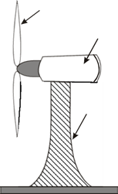
Propellor blades
Gea r b ox & gene ratro
Wind dire ction
Tow er
Fig. 5.12 Wind mill

Slide 82
2. Wind farms
When a large number of wind mills are installed and joined together in a definite pattern it forms a wind farm.
The wind farms, produce a large amount of electricity.
Condition
The minimum speed required for satisfactory working of a wind generator is 15 km / hr.
Advantages
It does not cause any air pollution.
It is very cheap.

Slide 83
5.13.3 Ocean energy
Ocean can also be used for generating energy in the following ways.
I Tidal energy (or) Tital power
Ocean tides, produced by gravitational forces of sun and moon, contain enormous amount of energy.
The ‘high tide’ and ‘low tide’ refer to the rise and fall of water in the oceans. The tidal energy can be harnessed by constructing a tidal barrage.
During high tide, the sea-water is allowed to flow into the reservoir of the barrage and rotates the turbine, which inturn produces electricity by rotating the generators.

Slide 84
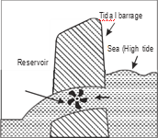
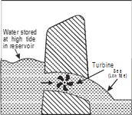
Fig. 5.13 (a)
Fig. 5.13 (b)
Fig. 5.13 (a) Water flows into the reservoir from sea.
Fig. 5.13 (b) Water flows out from the reservoir to the sea.

Slide 85
During low tide, when the sea level is low, the sea water stored in the barrage reservoir is allowed to flow into the sea and again rotates the turbine.
There is often large temperature difference between the surface level and deeper level of the tropical oceans.
This temperature difference can be utilized to generate electricity.
The energy available due to the difference in temperature of water is called ocean thermal energy.
Condition
The temperature difference should be of 20°C (or) more is required between surface water and deeper water.

Slide 86
Process
The warm surface water of ocean is used to boil a low boiling liquid like ammonia. The high vapour pressure of the liquid, formed by boiling, is then used to turn the turbine of the generator and generates electricity.
The cold water from the deeper ocean is pumped to cool and condense the vapour into liquid.
3. Geo- thermal energy
Temperature of the earth increases at a rate of 20 − 75°C per km, when we move down the earth surface.
High temperature and high pressure steam fields exist below the earth’s surface in many places.
The energy harnessed from the high temperature present inside the earth is called geothermal energy.

Slide 87
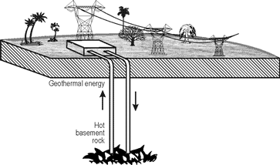
Fig. 5.14 Geo-thermal Energy

Slide 88
1. Natural geysers
In some places, the hot water (or) steam comes out of the ground through cracks naturally in the form of natural geysers.
2. Artificial geysers
In some places, we can artificially drill a hole up to the hot region and by sending a pipe in it, we can make the hot water (or) steam to rush out through the pipe with very high pressure.
Thus, the hot water (or) steam coming out from the natural (or) artificial geysers is allowed to rotate the turbine of a generator to produce electricity.
5.13.4 Biomass energy
Biomass is the organic matter, produced by plants (or) animals, used as sources of energy.
Most of the biomass is burned directly for heating, cooling and industrial purposes.

Slide 89
Examples
Wood, crop residues, seeds, cattle dung, sewage, agricultural wastes, etc., Biomass energies are of any one of the following types.
1. Biogas
Biogas is a mixture of gases such as methane, carbon dioxide, hydrogen sulphide, etc.,
It contains about 65% of methane gas as a major constituent.
Biogas is obtained by the anaerobic fermentation of animal dung (or) plant wastes in the presence of water.

Slide 90
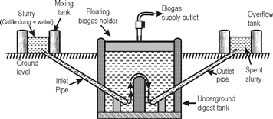
Fig. 5.15 Biogas Plant

Slide 91
2. Biofuels
Biofuels are the fuels, obtained by the fermentation of biomass.
Example Ethanol, methanol.
(a) Ethanol:
Ethanol can be produced from the sugarcane.
Its calorific value is less when compared to petrol, and produces much less heat than petrol.
(b) Methanol:
Methanol can be easily obtained from ethanol (or) sugar-containing plants.
Its calorific value is also too low when compared to gasoline and diesel.
(c) Gasohol:
Gasohol is a mixture of ethanol + gasoline.
In India trial is being carried out to use Gasohol in cars and buses.

Slide 92
3. Hydrogen Fuels
Hydrogen can be produced by thermal dissociation (or) photolysis (or) electrolysis of water.
It possess high calorific value.
It is non -polluting, because the combustion product is water.
2H + O −−−−−> 2H O + 150 kJ
Disadvantages of hydrogen fuel
Hydrogen is highly inflammable and explosive in nature.
Safe handling is required.
It is difficult to store and transport.
2
2
2

Slide 93
5.14 ENERGY CYCLE
Energy cycle, is the interactions between energy sources within the Earth’s environment.
These interactions are very complex and even small changes in them can lead to significant changes in long-term climate behavior.
Illustration
A simple illustration of the major elements of the energy cycle is shown in the figure. 5.16 Soil moisture is an important factor in the absorption and reflection of the sun’s energy by the earth’s surface.

Slide 94
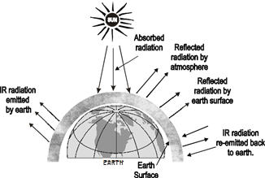
Fig. 5.16: Energy Cycles

Slide 95
Important energy cycles
Carbon cycle.
Nitrogen cycle.
Phosphorus cycle.
5.14.1 Carbon cycle
Definition
Carbon cycle is the movement of carbon (or) carbon compounds continuously from the atmosphere to the earth and then back into the atmosphere.
(Or)
Carbon cycle is the process where carbon compounds are interchanged among the biosphere, geosphere, hydrosphere and atmosphere of the earth.

Slide 96
Carbon in the atmosphere is present in the form of carbon dioxide.
Carbon enters the atmosphere through natural process such as respiration and industrial applications such as burning of fossil fuels
Sources of CO in atmosphere
During respiration, plants and animals liberates CO in the atmosphere.
Combustion of fuels also release CO .
Volcanic eruptions also release CO .
Various steps involved in carbon cycle
Carbon cycle involves the following 5 important steps.
2
2
2
2

Slide 97
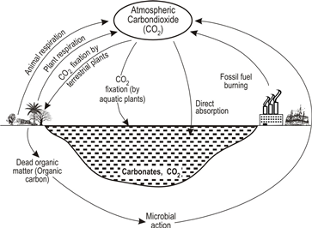
Fig. 5.13 Carbon cycle

Slide 98
Step I:
Carbon present in the atmosphere is absorbed by plants by the processes photosynthesis, which involves the absorption of CO by plants to produce carbohydrates (producers).
CO + H O + energy −−−−−> (CH O) + O
Step II:
These plants are then consumed by animals and carbon gets bioaccumulated into their bodies (consumers).
Step III:
These animals and plants eventually die and decomposers eat the dead organism and return the carbon from their body back into the atmosphere (decomposers)
CH O) + O −−−−−> CO + H O + energy
2
2
2
2
n
2
2
n
2
2
2

Slide 99
Step IV:
Some of the carbon that is not released back into the atmosphere eventually become fossil fuels.
Step V:
These fossil fuels are then used for man-made activities, which pump more carbon back into the atmosphere.
Importance (or) benefits of carbon cycle
It plays a vital role in balancing the energy and traps the long-wave radiations from the sun ie., it acts like a blanket over the planet, avoids global warming.
Carbon cycle is an important aspect of the survival of all life on earth.
Carbon is the building block of life and forms bonds with other elements necessary for life.

Slide 100
5.15 CARBON EMISSION AND SEQUESTRATION
5.15.1 Carbon emission
Carbon emission is the release of green house gases and their precursors into the atmosphere over a specified area and period of time.
Types of carbon emission
Carbon (Green house gas) emissions are classified into two scopes.
1 Scope 1 emissions (or) Direct emission
Scope 1 emissions are direct emissions from company.
It is divided into 4 categories.

Slide 101
(a) Stationary combustion
All fuels that produce GHG.
(b) Mobile combustion
All vehicles owned by a firm, burning fuel.
Example: cars, vans, trucks.
(c) Fugitive emissions
These are leaks from green house gases (GHG).
Example
Refrigeration, air-conditioning units.
(d) Process emissions
These are from industrial processes and on-site manufacturing.
Example
Cement manufacturing, chemical manufacturing.

Slide 102
II Scope 2 emissions (or) Indirect emission
Scope 2 emissions are indirect emissions from the generation of purchased energy (purchased electricity steam, heat and cooling) from a utility provider (end user).
Sources (or) Causes of carbon emission
1. Natural sources of CO emission
It includes
Decomposition of matter.
Ocean release.
Respiration.
Most animals, which exhale CO as a waste product.
Carbonate rocks.
2
2

Slide 103
2. Human sources of CO emission
It includes
Burning of fossil fuels like coal, natural gas and oil.
Deforestation.
Industrial activities like cement manufacture, oil refineries and leather industries.
Transportation sector generates largest amount of CO in the atmosphere.
Harmful effect of carbon emission
Carbon emission, nothing but emission of green house gas, affects the planet significantly.
It causes global warming and affects climate change.
2
2

Slide 104
Reduction of carbon emission
There are many ways to reduce green house gas emissions like
energy efficiency.
fuel switching.
combined heat and power.
use of renewable energy.
more efficient use.
recycling of materials.
plant more trees.

Slide 105
reduce air travel.
driving more efficient.
5.15.2 Carbon sequestration
It is the process of capturing and storing atmospheric carbondioxide.
It is one method of reducing the amount of CO in the atmosphere.
Goal of carbon sequestration is to reduce global climate change.
25% of our carbon emissions have been captured by earth’s forests, farms and grassland.
Scientists and land managers are working to keep landscapes vegetated and soil hydrated for plants to grow and sequester carbon.
2

Slide 106
30% of the carbon dioxide, we emit from burning fossil fuels, is absorbed by the upper layer of the ocean.
45% of carbon dioxide stays in the atmosphere the rest in sequestered naturally by the environment.
Concept (or) Aim of carbon sequestration
The concept of carbon sequestration is to stabilize carbon in solid and dissolved forms so that it doesn’t cause the atmosphere to warm.
The process shows tremendous promise for reducing the human “carbon foot print”.

Slide 107
Method (or) Types of carbon sequestration
There are three main types of carbon sequestration.
1. Biological carbon sequestration
It is the storage of CO in vegetation like grassland, forests, soils and oceans.
2. Geological carbon sequestration
It is the process of storing CO in underground geologic formations (or) rocks.
Typically, CO is captured from an industrial sources like steel (or) cement production, power plant and injected into the porous rocks for long-term storage.
3. Technological carbon sequestration
Scientists are using innovative technologies to remove and store carbon from the atmosphere using innovative technologies.
2
2
2

Slide 108
Example: Graphene production
The use of CO as a raw material to produce graphene (a technological material).
Graphene is used to create screens for smart phones and other technical devices.
Graphene production is an example of how CO can be used as a resource and a solution in reducing emissions from atmosphere.
Advantages and disadvantages of carbon sequestration
Advantages (or) merits
Carbon sequestration prevents the occurrence of climate change.
Deep injection of CO improves the extraction of fuels like oil and methane from their reserves in addition to removing excess pollutants from the air.
Since the gas can be easily liquefied, it can be easily transmitted through pipelines.
2
2
2

Slide 109
No CO leaking out from the injection site.
It lowers carbon emission by 80% to 85% while using fossil fuels.
Disadvantages (or) limitations
Due to carbon sequestration, in power plants, 40% additional coal is consumed and hence cost of energy gets increased by 1 to 5% per kilowatt hour.
CO from power plant emissions must be captured and liquified, which uses a lot of electrical power.
It can be disastrous if the injected gas leaks due to structural flaws in the geological formation.
The ocean can become acidic due to the large amounts of carbon dioxide being injected into it, endangering aquatic life.
2
2

Slide 110
Planting trees, with the intention of storing and absorbing carbon, requires more time for the trees to mature.
There is no enough available geological resources to sequester carbon.
The concentration of CO , from power plant exhaust is too low for being effectively liquified.
5.16 GREEN ENGINEERING
5.16.1 Definition
Green engineering is the design, commercialization and use of processes and products that minimizes pollution, promotes sustainability and promotes human health without affecting environment.
2

Slide 111
5.16.2 Examples for green engineering
Biodegradable cups and straws.
Enhanced industrial emission filters.
Waste water treatment.
Radiant floors (heat homes efficiently by installing warming tubes under a floor).
Plant-based cooling (an alternate cooling solution using plants and trees installed around (or) on a building)
5.16.3 Goal of green engineering
Decrease in the amount of pollution that is generated by a construction.
Minimization of human population exposure to potential hazards (reducing toxicity).
Improved uses of matter and energy throughout the life cycle of the product.

Slide 112
Maintaining economic efficiency and viability.
Reduces energy and water consumption.
Reduces waste and our carbon footprint.
Improves business efficiency by lowering costs while improving the product design and creating new jobs.
5.16.4 Principles of green engineering
All materials and energy inputs and outputs are inherently non-hazardous as possible.
It is better to prevent waste that to treat (or) clean up waste after it is formed.
Separation and purification operations should be designed to minimize energy consumption and material use.

Slide 113
Products, processes and systems must be designed to maximize mass, energy, space and time efficiency.
Products, processes and system should be “output pulled” rather than “input pushed” through the use of energy and materials.
Complexity must be viewed as an investment when making design choices on recycle, reuse.
Durability rather than immortality should be a design goal.
Material diversity in multi-component products should be minimized.
Design of products, processes and system must include integration and inter-connectivity with available energy and materials flow.
Products should be designed for performance in a commercial “after life”.
Material and energy inputs should be renewable rather than depleting.

Slide 114
5.16.5 Benefits of green engineering
This process enhances business practices by eliminating improper production methods.
It improves a company’s reputation by showing consumers it cares about the environment.
It minimizes energy (or) production waste.
It provides tax incentives.
It helps the global environment.
It reduces air, water and soil pollutions.
It provides new business opportunities.

Slide 115
5.16.6 Limitations (or) disadvantages of green engineering
R & D costs, production and implementation costs are high.
Implementation will take many years.
Green technology is still quite immature.
Some companies may go out of business.
Job losses.
Sophisticated regulatory frame work needed.
Not everything that is labeled as green is actually green.

Slide 116
5.17 SUSTAINABLE URBANIZATION
Urbanization is the movement of human population from rural areas to urban areas for the want of better education, communication, health, employment, etc., without affecting the environment and needs of future generations.
5.17.1 Rules to develop a sustainable urbanization
Sustainable transportation.
Sustainable urban development.
Climate change mitigation and landscape architecture.
Resilient design (regarding natural hazards).
Applying ecological design.

Slide 117
Improving water efficiency.
Increasing energy efficiency.
Using low-impact materials.
By following the above rules, urbanization can be made into sustainable.
5.17.2 Pillars of sustainable urbanization
Sustainability is based on three functional areas ie., social, environmental and financial/economical.
These functional areas are interconnected and must be considered together.
The place where these all meet and are balanced is the goal of sustainability.

Slide 118
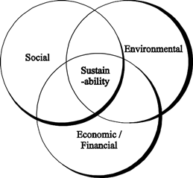
Fig. 5.18 Functional areas of urban sustainability

Slide 119
The goal of urban sustainability is to prevent resource availability issues for existing (or) future generations.
It also minimizes an urban area’s impact on its ecosystem.
5.17.3 Advantages and disadvantages of sustainable urbanization
Advantages
Urbanization creates convenience.
Urban economies can be better than rural ones.
Provides better education.
Get better housing.
Provides better social life.

Slide 120
Provides better healthcare services.
More security and police availability.
More entertainment options.
More tourist attractions.
More places to shop in urban areas.
Disadvantages
Over crowding in urban areas.
Buying a house might be a challenge.
Decline in rural area.

Slide 121
Too much crime occurs in urban area.
Unemployment problem is more.
Cost of living is higher.
No privacy.
Pollution problem is more.
5.18 SOCIO – ECONOMICAL CHANGE ON SUSTAINABLE URBANIZATION
Urbanization has many adverse effects on the structure of society because,
gigantic concentrations of people compete for limited resources.

Slide 122
rapid housing construction leads to overcrowding.
slums, which experience major problems such as poverty, poor sanitation, unemployment.
it leads to higher crime rates and pollution.
it also leads to increased levels of inequality and social exclusion.
environmental degradation is occurring very rapidly causing problems like land insecurity, excessive air pollution, waste disposal problems.

Slide 123
5.18.1 Technological change on sustainable urbanization
Technological change involves the introduction of something new (or) a new idea, method (or) device.
Technological innovations, as part of technological change, allows organisations to test new ideas at speeds and prices that were newer anticipated a decade ago.
Technological innovation has changed the overall effectiveness and benevolence over time and with regard to sustainability.
Upgrading of industrial structure improves the sustainable urbanization.
Technological change and sustainability are closely related to each other.

Slide 124
Both factors form the innovation inorder to improve the effectiveness of environmental and social development and economic progress.
The combination of digital technology in the business model will establish and empower a city to be more sustainable.

